Slide 1
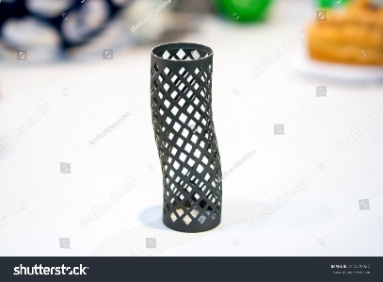
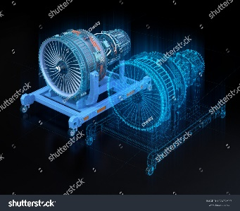
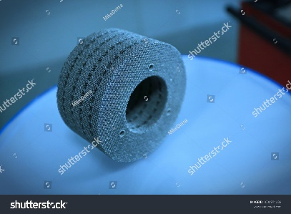
MANUELA - Additive Manufacturing using Metal Pilot Line
Services
One-stop-shop for full AM development cycle including simulation, robust AM manufacturing and on-line process control, characterization, real-time feedback, post-treatment and AM qualification protocols.
Uses Powder Bed Fusion Laser Beam (PBF-LB) and Electron Beam (PBF-EB).
Benefits
First time right product design | Time to market reduction | Flexible product design enabling complex geometries | Manufacturing cost reduction | Optimized material utilization | Enhanced product differentiation
Cooperation opportunity - Open Call
Support for introducing metal AM in your product development with 50% co-financing.
Open to any company regardless of size or industry established in EU or associated country.
Applications can cover any or all phases and aspects of metal-based AM – development of ideas, prototyping, materials assessment, process improvement, etc.
All information available at www.manuela-project.eu

